Slide 1

Branch - CSE Python Programming
Lecture – 10 Loops and Iterations – Part 1
By
Dr. Smita Tiwari
Assistant Professor
Department of Computer Science and Engineering
School of Engineering & Technology

Slide 2
Loops in Python
Python provides following types of loops to handle loop requirements.
While Loops
For Loops
In python, while loop is used to execute a block of statements repeatedly until a given a condition is satisfied. And when the condition becomes false, the line immediately after the loop in program is executed.

Slide 3
While Loop
while (expression):
S1
S2
FALSE
expression
TRUE
S1
S2
Evaluate expression
If TRUE then
execute statement1
goto step 1.
If FALSE then execute statement2.

Slide 4
Program…
n = int(input('Enter a number: '))
print (n, 'X', 1, '=', n*1)
print (n, 'X', 2, '=', n*2)
print (n, 'X', 3, '=', n*3)
print (n, 'X', 4, '=', n*4)
print (n, 'X', 5, '=', n*5)
print (n, 'X', 6, '=', n*6)
….
Too much
repetition!
Can I avoid
it?

Slide 5
Printing Multiplication Table
5 | X | 1 | = | 5
5 | X | 2 | = | 10
5 | X | 3 | = | 15
5 | X | 4 | = | 20
5 | X | 5 | = | 25
5 | X | 6 | = | 30
5 | X | 7 | = | 35
5 | X | 8 | = | 40
5 | X | 9 | = | 45
5 | X | 10 | = | 50

Slide 6
Printing Multiplication Table
Loop Entry
Input n
i = 1
Loop Exit
i <=10
TRUE
FALSE
Print n X i = n*i
i = i+1
Stop
Loop

Slide 7
Printing Multiplication Table
Input n
i = 1
n = int(input('n=? '))
i = 1
while (i <= 10) :
print (n ,'X', i, '=', n*i)
i = i + 1
print ('done‘)
TRUE
i <=10
FALSE
Print n x i = ni
i = i+1
Stop

Slide 8
For Loop
Print the sum of the reciprocals of the first 100 natural numbers.
rsum=0.0# the reciprocal sum
# the for loop
for i in range(1,101):
rsum = rsum + 1.0/i
print ('sum is', rsum)

Slide 9
For loop
For loops are used for sequential traversal.
For example: traversing a list or string or tuple etc.
In Python, there is no C style for loop, i.e., for (i=0; i<n; i++).
There is “for in” loop which is similar to for each loop in other languages.
Next slide shows the syntax.

Slide 10
For loop in Python
General form
for variable in sequence:
stmt

Slide 11
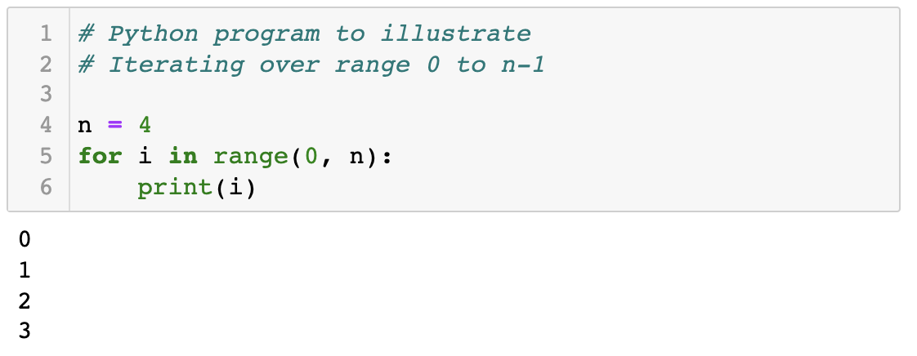
For loop

Slide 12
range
range(s, e, d)
generates the list:
[s, s+d, s+2*d, …, s+k*d]
where s+k*d < e <= s+(k+1)*d
range(s, e) is equivalent to range(s, e, 1)
range(e) is equivalent to range(0, e)
Exercise: What if d is negative? Use python interpreter to find out.

Slide 13
Quiz
What will be the output of the following program
# print all odd numbers < 10
i = 1
while i <= 10:
if i%2==0: # even
continue
print (i, end=‘ ‘)
i = i+1

Slide 14
Continue and Update Expr
Make sure continue does not bypass update-expression for while loops
# print all odd numbers < 10
i = 1
while i <= 10:
if i%2==0: # even
continue
print (i, end=‘ ‘)
i = i+1
i is not incremented
when even number
encountered.
Infinite loop!!

Slide 15
THANK YOU

